Slide 1
Haskell With Go Faster Stripes
Neil Mitchell
λ

Slide 2
Catch: Project Overview
Catch checks that a Haskell program won’t raise a pattern match error
  head [] = error “no elements in list”
  Infer preconditions, postconditions
Lots of progress
  Mainly in the details
  Nothing both new and exciting

Slide 3
The Catch Pipeline
Haskell source code
Core Haskell language – using Yhc
Haskell Intermediate Little Language
Transform to First Order HILL
Analysis

Slide 4
Higher Order Code
A function is passed around as a value
head (x:xs) = x
map f [] = []
map f (x:xs) = f x : map f xs
main x = map head x

Slide 5
Higher Order, Point Free
Point free/pointless code
Does not mention the data values
even = not . odd
(f . g) x = f (g x)
even x = not (odd x)

Slide 6
Step 1: Arity Raise
If a function can take more arguments, give it more!
(.) takes 3 arguments, even gives (.) 2, therefore even takes 1
even x = (.) not odd x

Slide 7
Step 2: Specialise
If a function is passed higher order, generate a version with that argument frozen in:
even x = (.) not odd x
even x = (.)<not odd> x
(.)<not odd> = not (odd x)

Slide 8
Fall back plan…
Reynolds Style Defunctionalisation
Generate a data value for each function
data Func = Not | Odd | …
ap Not x = not x
ap Odd x = odd x
…

Slide 9
First Order HILL
We now have First Order HILL
The analysis is now happy
But have we got faster code?
  Reynold’s style defunc is slow, but rare
  Longer code, not necessarily slower

Slide 10
Reordering the operations
Arity raising
Reynold’s Style Defunc
Specialisation
Now both functions and data are specialised!

Slide 11
The Competition
GHC – Glasgow Haskell Compiler
Optimising compiler for Haskell
A lot of work has been done with GHC
Speed competes with C!
Based on inlining

Slide 12
Inlining vs Specialisation
ex1 = cond True 0 1
cond x t f =
case x of
True -> t
False -> f

Slide 13
Inlining
ex1 = case True of
True -> 0
False -> 1
ex1 = 0

Slide 14
Specialisation
ex1 = cond<True> 0 1
cond<True> t f = t
Cond<True> is now just a “forwarder”, so is inlined
ex1 = 0

Slide 15
Inlining vs Specialisation
caller
Specialisation
callee
Inlining
… (f x) …
f x = …

Slide 16
Termination condition
Inlining
  Do not inline recursive groups
Specialisation
  Based on types
  (1,’a’:’b’:[]):(3,[]):(4,[])

Slide 17
Another few examples
map f [] = []
map f (x:xs) = f x : map f xs
ex2 f = map f []
ex3 x = map head x
Inlining fails both of these*!
* Do not try this at home…

Slide 18
Specialisation
map<[]> f = []
ex2 f = map<[]> f
ex2 f = []
map<head> [] = []
map<head> (x:xs) = head x : map<head> xs
ex3 x = map<head> x

Slide 19
Specialisation Disadvantages
Works best with whole program
  Computers are now much faster
  Does this really matter?
Not as well studied
Code blow up (in practice, small)
Can use with inlining!

Slide 20
Pick a random benchmark…
Calculate the n^{th} prime number
In the standard nofib benchmark suite
Lots of list traversals
Quite a few higher order functions
About 15 lines long
Let’s compare!

Slide 21
Executing HILL
HILL is still very Haskell like
Take the fastest Haskell compiler (GHC)
Convert HILL to Haskell
Compile Haskell using GHC
Take note: benchmarking GHC against HILL + GHC (GHC wins regardless?)

Slide 22
Attempt 1: Draw
Both are the same speed using –O2
Using –O0, HILL beats GHC by 60%
–O2 vs –O0 speeds HILL by 10%
Suggests HILL is doing most of the work?

Slide 23
List fusion
GHC has special foldr/build rules
Specialise certain call sequences
Built in, gives an advantage to GHC, but not to HILL
Applies 4 places in the Primes benchmark

Slide 24
Add General Fusion to HILL
Implemented, about an afternoon’s work (taking liberties)
Works on all data types, even non-recursive ones
Can deforest (!!), foldr/build can’t
Applies 6 times

Slide 25
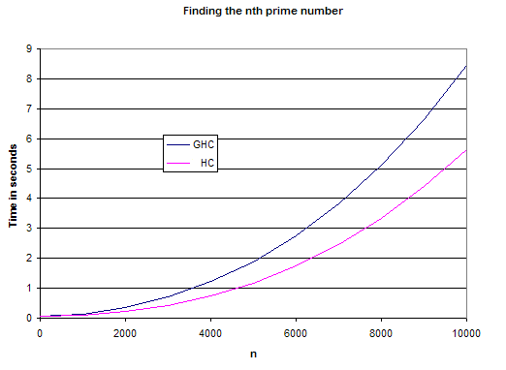
Results
30%

Slide 26
Beware
One benchmark
Using GHC as the backend
But consistent improvement
One other benchmark (Exp3_8), 5% improvement, written close to optimal

Slide 27
Future Work
Speed up transformations
Be more selective about specialisation
More benchmarks
  Whole nofib suite
Native C back end

Slide 28
C backend
Catch: Haskell -> Yhc Core -> HILL -> First Order HILL -> Haskell
GHC: Haskell -> GHC Core -> STG -> C
Haskell can’t express some features of HILL (unnecessary case statements)
STG copes with higher order functions

Slide 29
Conclusion
All programs can be made first order
Some Haskell programs can go faster
Specialisation is an interesting technique
More benchmarks will lead to more conclusions!

